Slide 1

Gregor Black
Personal Intelligence Dossier
@gregorablack
2026-03-08

Slide 2
Digital Footprint
Bio: ""Me gusta mi voz en español mas que inglés Venice,LA 📸 🏠 @gb.noir.lugar""
Followers: 1428 | Following: 2443 | Posts: 143
Link in bio: https://calendar.app.google/iyF32237s5w3geRS8
Story highlights: 5 highlight reels
Content themes: Based on 7 post captions analyzed via Apify.
Engagement rate: 13.9% (187 avg likes + 11 avg comments / 1428 followers)
Post frequency: 10 recent posts analyzed
Comment quality: 49 unique commenters across 63 comments
Sources: www.instagram.com/gblackattack/ | www.instagram.com/gregorablack/ | www.instagram.com/gregorablack/p/DRnYGXECS8A/

Slide 3
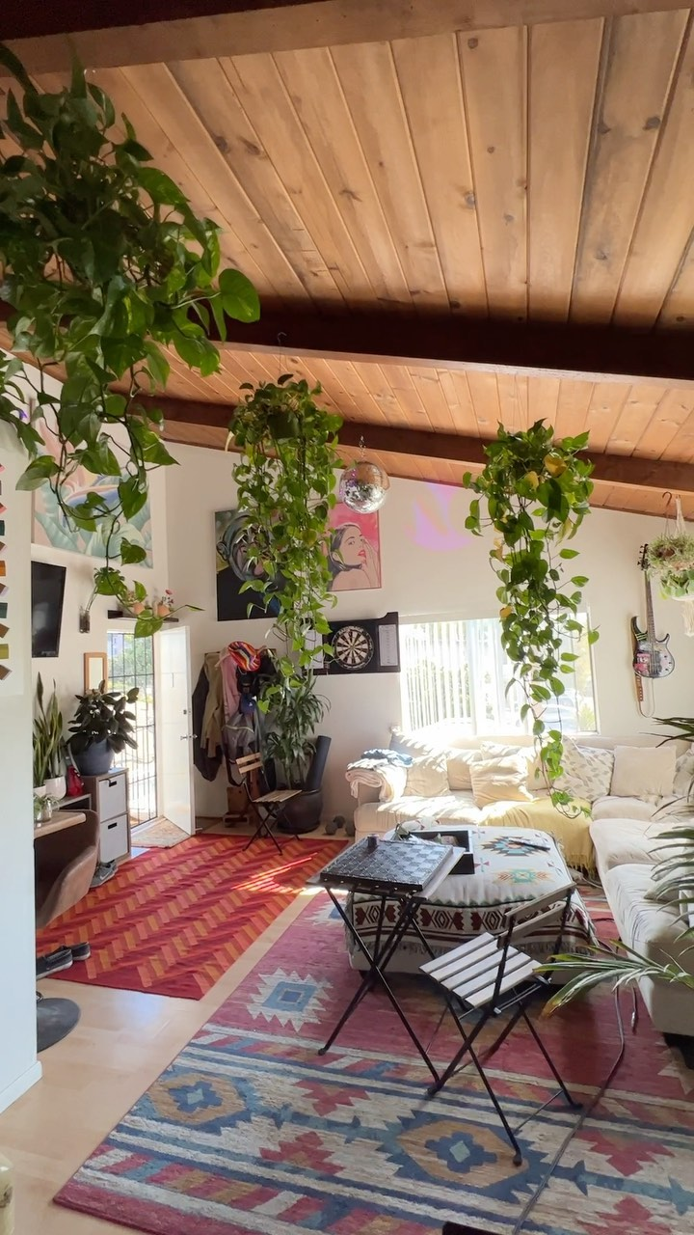
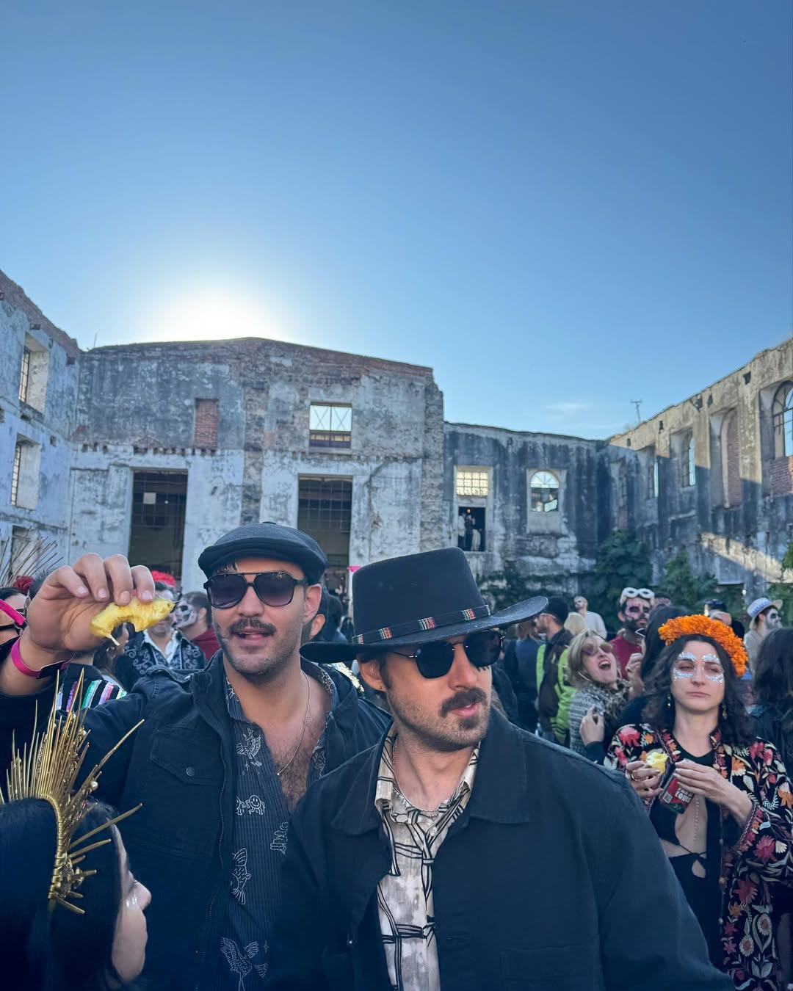
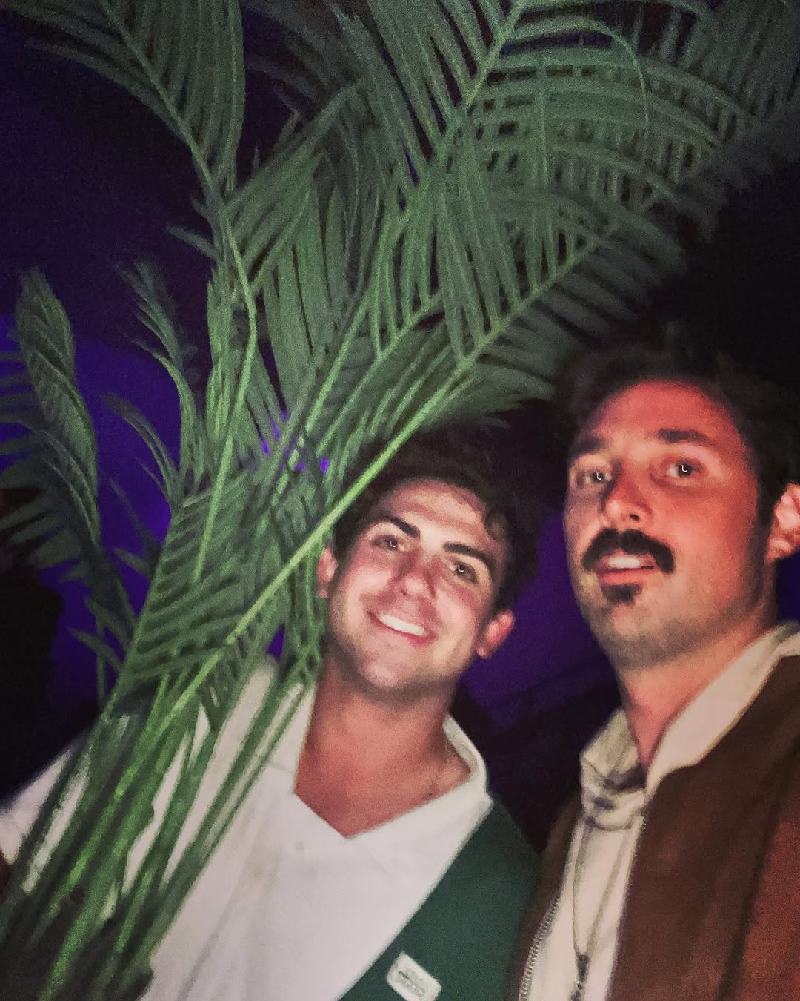
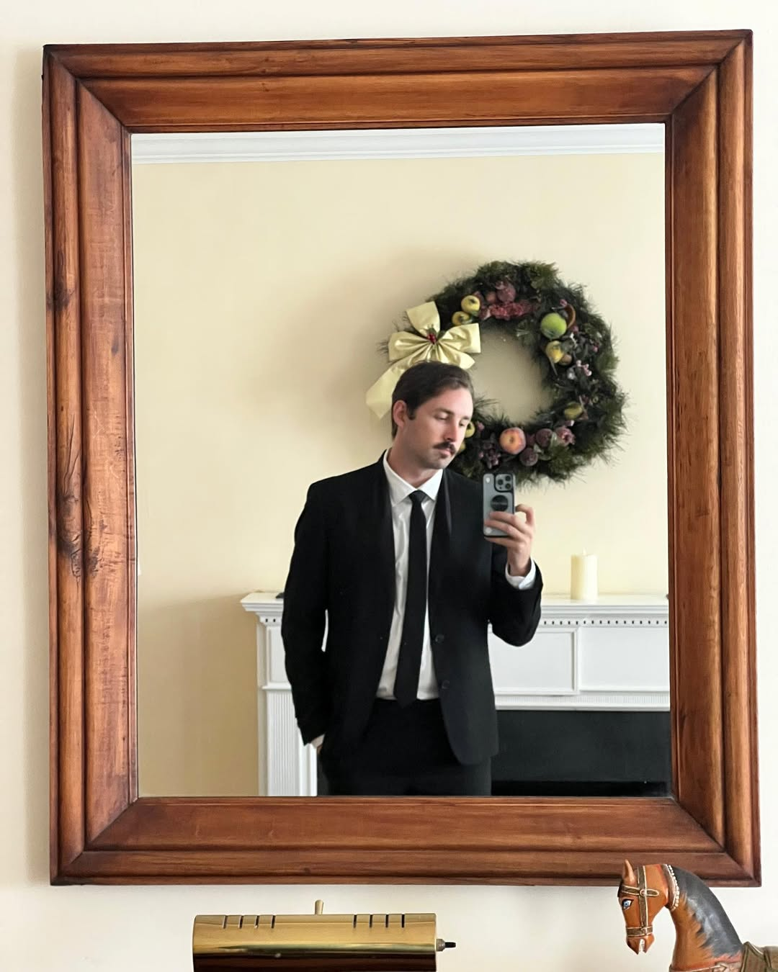
Photo Board

Slide 4
Personal Life
Influences
@category4mike — tagged/mentioned in posts | @jsondiaz — tagged/mentioned in posts | Conversation Starters (Personal) | 1. Bio reference: "Your bio says \"Me gusta mi voz en español mas que inglés Ven
Hobbies / Lifestyle
Based on 7 post captions analyzed via Apify.
Sources: www.linkedin.com/in/gregory-black-gbautomation/ | www.linkedin.com/in/gregory-black-gbautomation/?_l=en | www.linkedin.com/posts/gregory-black-gbautomation_n8n-aut...

Slide 5
Conversation Starters
Bio reference: "Your bio says \"Me gusta mi voz en español mas que inglés Venice,LA 📸 🏠 @gb.noir.lugar\" — what does that mean to you?"
Post reference: "You posted \"Some incredible days recently...\" — what was that about?"
Post reference: "You posted \"Much love lately 💕...\" — what was that about?"
Post reference: "You posted \"Just a couple of plant guys at the afters...\" — what was that about?"
Connection: "How do you know @jsondiaz?"
Sources: www.instagram.com/p/CfVrjDFgCPB/ | www.instagram.com/p/CuStB3aMpHZ/ | www.instagram.com/p/CsPCnk-vo5g/

